Slide 1
Applications of MAPSAT in Educational Research
Map & Analyze Patterns & Structures Across Time

Slide 2
Applications of MAPSAT in Educational Research Map & Analyze Patterns & Structures Across Time
Theodore W. Frick
Rodney Myers
Craig Howard
Andrew Barrett
Professor and Chair Instructional Systems Technology School of Education Indiana University Bloomington, Indiana
Ph.D. candidates in IST Indiana University Bloomington, Indiana

Slide 3
Introduction to MAPSAT: Map & Analyze Patterns & Structures Across Time
Theodore W. Frick

Slide 4
Goal of research is to create knowledge
Knowledge: recorded signs of knowing (cf. Peirce, 1932; Short, 2007)
Educology: knowledge of education (Steiner, 1988)
Epistemologically, there are 3 basic kinds of educology. Knowledge of:
That one (unical): signs of a unique phenomenon (none other)
How to do (practical): signs of a way a person can do something (performative)
That (theoretical): signs of categories of phenomena; classificatory; generalizable
Instantial: categorize instances of phenomena by a symbolic sign (e.g., rain, snow, male, female, A, B)
Relational: associations between 2 or more categories of phenomena (e.g., A relation B)
Scientific: Claims* to explain or predict empirical phenomena (non-axiological; empirical; correspondence to observed phenomena)
Praxiological: Claims* about means to achieve ends (axiological; empirical; instrumental value)
Philosophical: Claims* about what is worthwhile (axiological; non-empirical; intrinsic value)
Criterial: rationally justifiable norms for judgment of categories of phenomena
*A knowledge claim is a set of signs, such as a sentence in English or Chinese, or it could be a mathematical expression to represent phenomena.

Slide 5
General form of a relation: A and B are categorical signs of phenomena; a relation is also a categorical sign
A relation B
Scientific claims: A causes B or A predicts B
Praxiological claims: A is a means to achieve the end B

Slide 6
Signs
C. S. Peirce (1932):
A sign, or representamen, is something which stands to somebody for something in some respect or capacity…. every representamen being thus connected with three things, the ground, the object, and the interpretant (2:228)…. The Sign can only represent the Object and tell about it. It cannot furnish acquaintance with or recognition of that Object; for that is what is meant in this volume by the Object of a Sign; namely, that with which it presupposes an acquaintance in order to convey some further information concerning it (2:231).
For further discussion on signs and kinds of knowing, see: The Theory of Totally Integrated Education (TIE) at: http://educology.indiana.edu/Frick

Slide 7
Signs of Functional, Temporal & Structural Relations between categories A and B
Mathematical Relation (linear function)
B = constant + slope × A
Temporal Relation
A precedes B
A co-occurs with B
Structural Relation (digraph or network)
A affect-relation B

Slide 8
Extant methods in educational research for making scientific and praxiological claims
Quantitative methods
Typically assume a linear, additive model to signify phenomena and their relations
Measure variables separately then use statistics to relate measures of phenomena (e.g., correlation, multiple regression, path analysis, hierarchical linear models, structural equations)
Can allow generalizability from sample to population
Qualitative methods
Assume words not numbers to signify phenomena and their relations
Can provide rich details of individual cases, including patterns
Typically lack generalizability from sample to population
Mixed methods
Utilize strengths of both approaches

Slide 9
MAPSAT: An alternative
With MAPSAT we map relations directly
‘Map relations’ using signs of qualitative categories, since we do not measure phenomena separately
Relations are viewed temporally or structurally, rather than statistically according to some assumed mathematical function
Analysis of Patterns in Time (APT)
Temporal relations of signs of qualitative categories within classifications (system dynamics)
Temporal maps are queried for categorical patterns of observed events, resulting in quantitative probability estimates for patterns
Analysis of Patterns in Configurations (APC)
System structure is determined by the observed configuration of affect-relations
Structural property values (quantitative) of maps determined from axiomatic theory (ATIS)

Slide 10
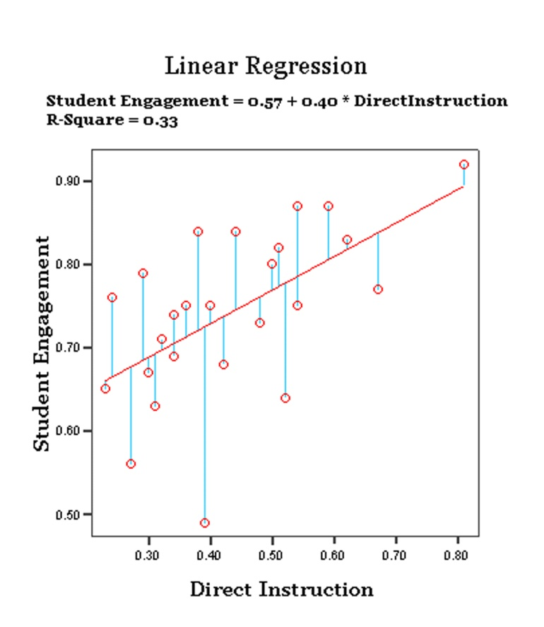
Example: APT and Academic Learning Time (ALT)
Observation of mildly handicapped students in classrooms
Instruction: Direct or non-direct; Student Behavior: Engaged or non-engaged
Temporal Relationships: Joint Occurrences of Direct Instruction (DI), Student Engagement (EN), Non-direct Instruction (ND), and Student Non-engagement (NE) in Columns 3 - 6; Conditional Occurrences in Columns 7 - 8
Joint occurrences of instruction and behavior
APTprob (If Direct Instruction, then Engagement?) = 0.967 APTprob (If Non-Direct Instruction, then Engagement?) = 0.573
Data were taken from Frick (1990) study published in AERJ.
Instruction and behavior aggregated separately 67% of variance is not predictable

Slide 11
Example: APT of course evaluation data
Analysis of relationships among scales related to Teaching and Learning Quality (TALQ)
If First Principles and Successful Engagement, then Student Mastery?

Slide 12
Example: APT and use of scaffolding strategies
Temporal map and APT query
Coding Example adapted from Joyce Koh’s dissertation (2008), p. 38. Cell entries have been highlighted in green to indicate instances of the pattern: If student interaction is Tech Help, then instructor interaction is Show N Tell?
In this sample, if the student asks the instructor for technical help, then this is
followed by instructor interaction that is ‘show and tell’ in 3 out of 5 occurrences
for an APT probability estimate of 0.60.

Slide 13
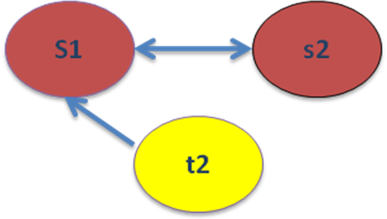
Analysis of Patterns in Configurations (APC)
Structure determined by affect-relations between components
In APC, we measure properties of system structure
Property measures were derived from Axiomatic Theories of Intentional Systems—ATIS (Thompson, 2006)
17 ATIS properties include: complexity, size, interdependence, independence, strongness, flexibleness, compactness, active dependence, wholeness, vulnerableness, …
Example of 'support' affect-relations

Slide 14
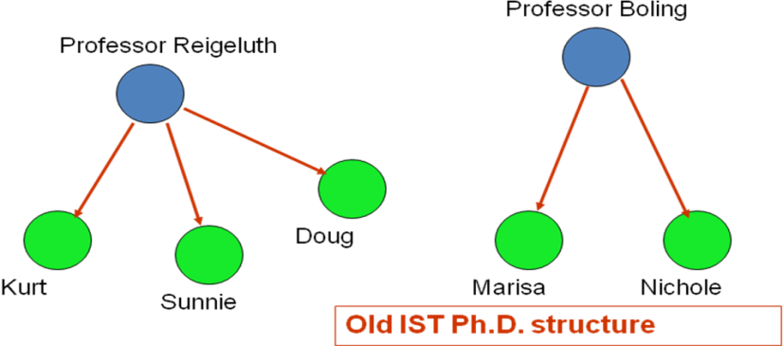
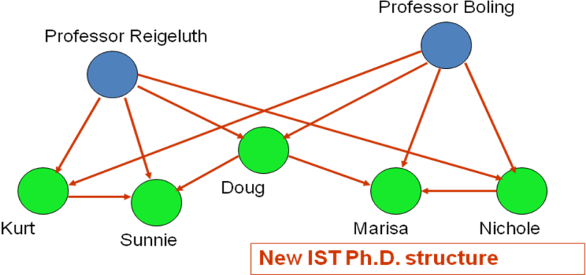
Example: APC of IST Ph.D. program
Comparison of ‘mentoring’ affect-relation

Slide 15
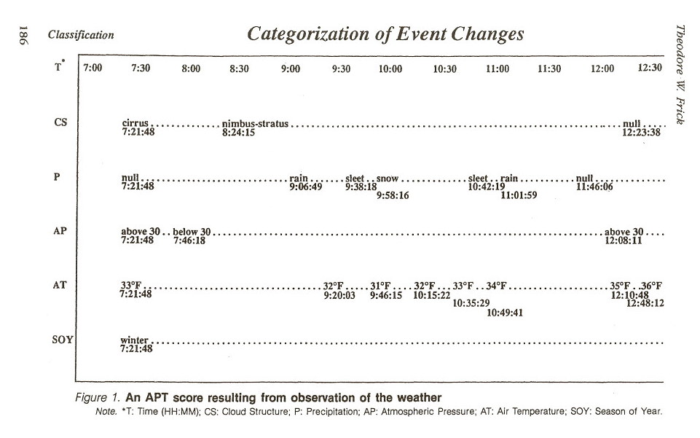

Slide 16
Traditional approach (Aggregation Aggravation)
Measure variables separately: e.g.,
How much it rained (aggregated separately from precipitation row)
Average temperature (determined separately from temperature row)
Do this repeatedly for more observation periods, for more x,y pairs of rain and temperature values.
Then correlate the two variables (e.g., Pearson r) to determine relationship between rain and temperature.
The sequential patterns or joint occurrences of changes in precipitation and temperature are lost in this approach.

Slide 17
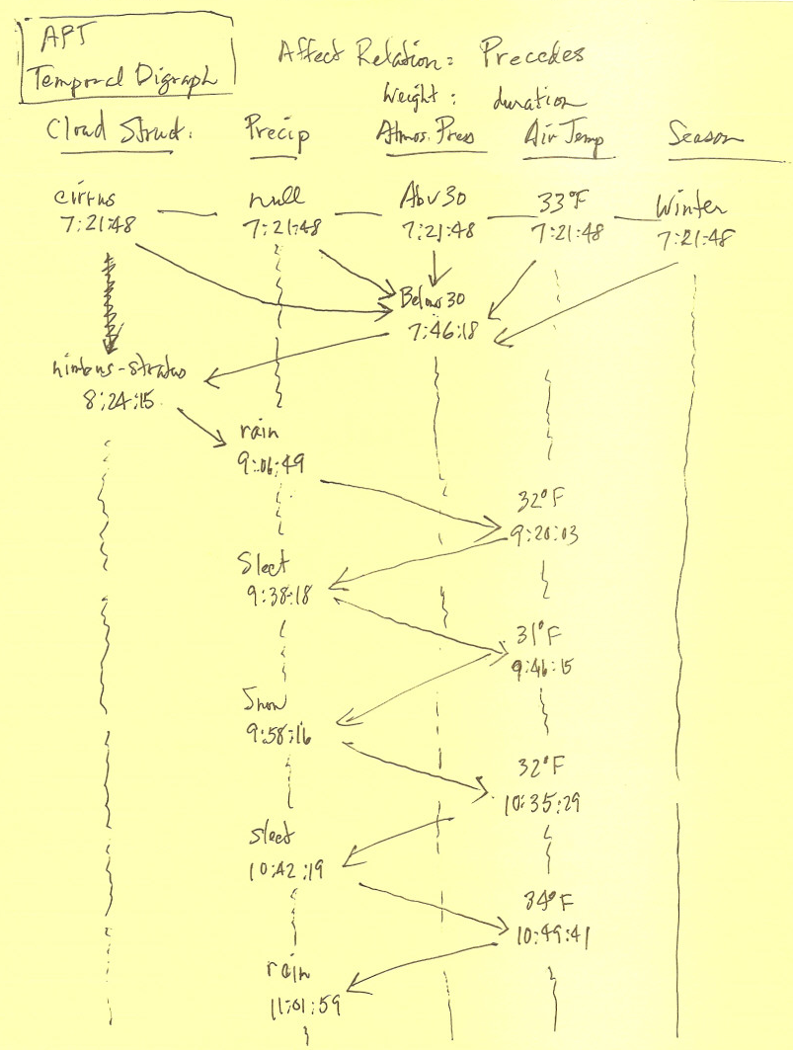
In APT we can see the sequence of changes (represented by the lines
with arrows).
This is a temporal digraph. The directed edges (lines with arrows) connect the vertices or nodes (event changes in each classification).
The affect relation is ‘precedes in time’.

Slide 18
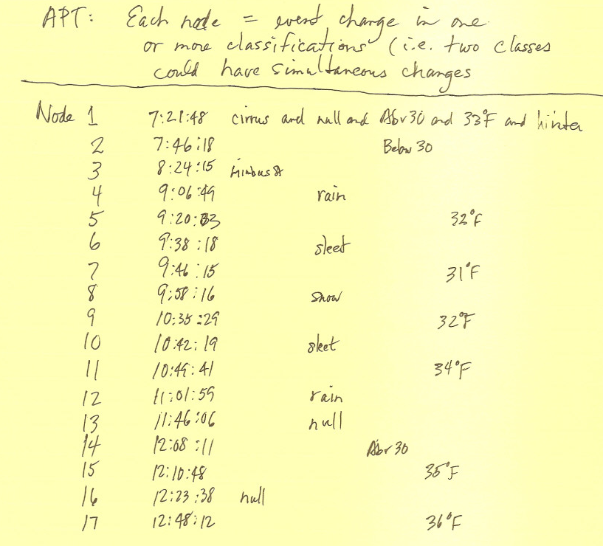

Slide 19
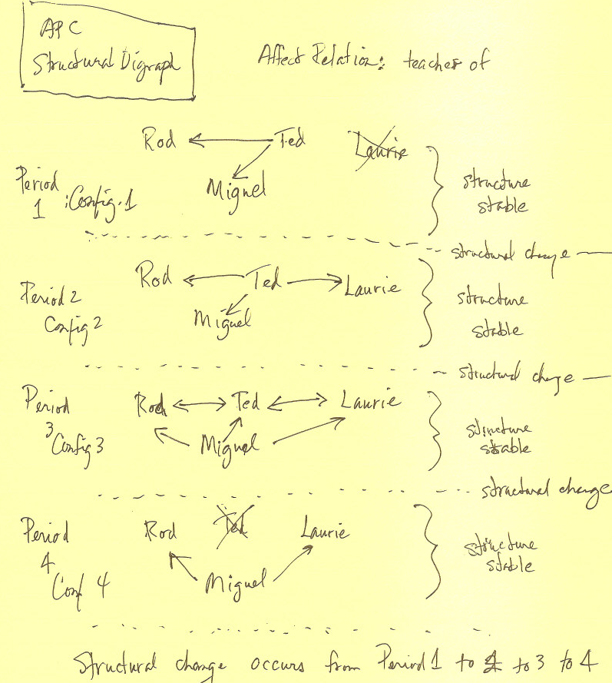
System structure can also be represented by a digraph.
Here the directed edges represent the affect relation: is the teacher of.
In configuration 1, Ted is the teacher of Rod, and Ted is the Teacher of Miguel.
In configuration 2, Ted is also the teacher of Laurie.
The structure has changed between configurations 1 & 2.

Slide 20
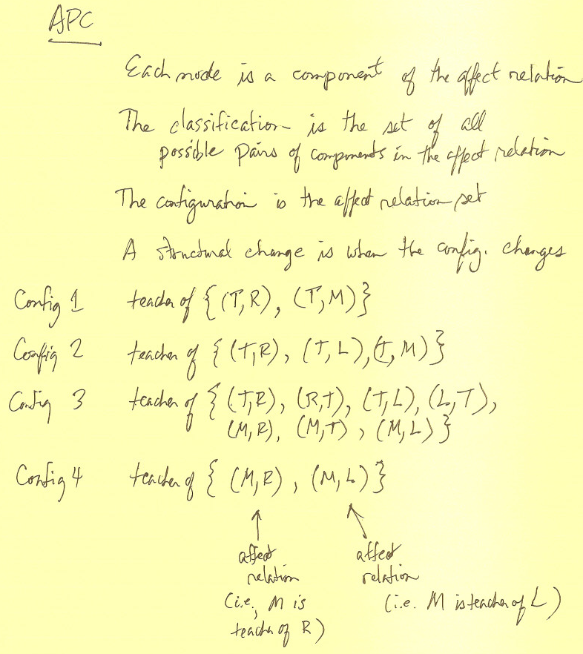
In APC we can measure properties of structure—e.g., complexity, strongness, interdependence, wholeness.
We can also measure change in structural properties when the structure changes between time 1 and time 2.
E.g., complexity of the affect relation structure for ‘is the teacher of’ is increasing from configuration 1 to 2 to 3. However, complexity decreases between configurations 3 & 4.

Slide 21
MAPSAT compared to traditional methods
Statistical analysis: relates measures
Regression, path analysis & hierarchical linear models: statistical association of separate measures
MAPSAT: maps relations
APT: temporal maps, based on chronological order of event occurrences
APC: structural maps of affect-relations, based on logic of predicates
We analyze and measure patterns in these temporal and structural configurations.

Slide 22
Analyzing Interaction Patterns to Verify a Simulation/Game Model
Rodney D. Myers

Slide 23
Analyzing Interaction Patterns to Verify a Simulation/Game Model
Problem
When games and simulations represent real-world systems and processes, designers must consider the degree of fidelity appropriate for various elements, including the external representation, the underlying model, and the interaction of the components (Alessi & Trollip, 2001; Reigeluth & Schwartz, 1989).
Practical question
How do we know we built it right?

Slide 24
Analyzing Interaction Patterns to Verify a Simulation/Game Model
Purpose
Formalize a method of verifying the accuracy of a simulation/game’s computational model
Research Questions
Is the proposed method effective in verifying the accuracy of computational models created for simulations and games?
What does the proposed method contribute that is not available through related methods?
What improvements can be made to the proposed method?

Slide 25
Case: The Diffusion Simulation Game (DSG)
Research Design
A single-case study (Yin, 2009) within the paradigm of educational design research (van den Akker et al., 2006)
Description of the Case
The Diffusion Simulation Game (DSG)
Original board game (1975-76) → online (2002)
Role/Context: Change agent at a junior high school
Objective: Persuade as many of the 22 staff members as possible to adopt peer tutoring.
Learning Objective: Understand and apply the theory of the diffusion of innovations, primarily Rogers (1962, 2003).

Slide 26
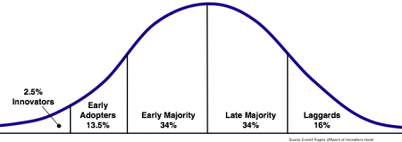
Case: The Diffusion Simulation Game (DSG)
Rogers’ Diffusion of Innovations Model
Innovation Decision Process
Knowledge → Persuasion → Decision → Implementation → Confirmation
DSG: Awareness → Interest → Trial → Adoption
Adopter Types
Innovator | Early Adopter | Early Majority | Late Majority | Laggard

Slide 27

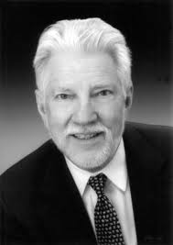
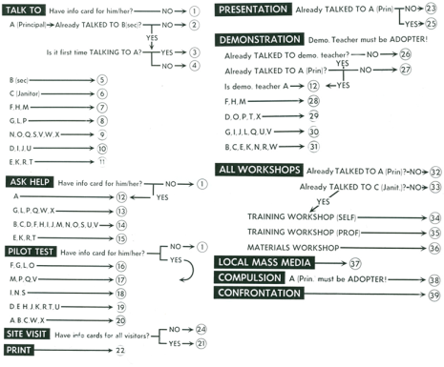
Case: The Diffusion Simulation Game (DSG)
Diffusion Simulation Game
Conceptual Model
if(awareness>1)
{interest++}
Real-World
Phenomenon
Computational Model

Slide 28
Case: The Diffusion Simulation Game (DSG)
Main components of the game
Number of Adopters
2 Year
Calendar
Adoption Phase
Activities
Staff Members & Personal Info

Slide 29
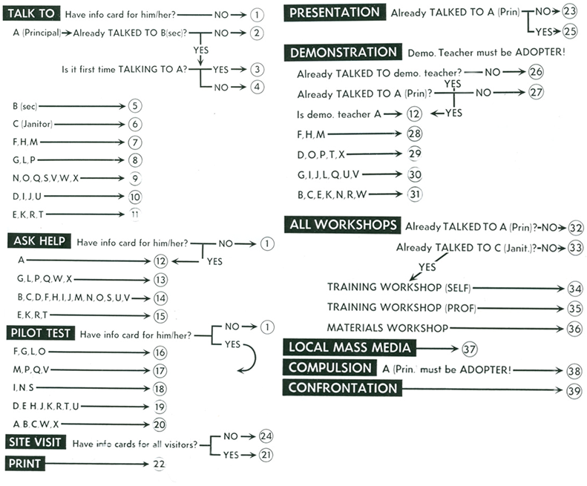
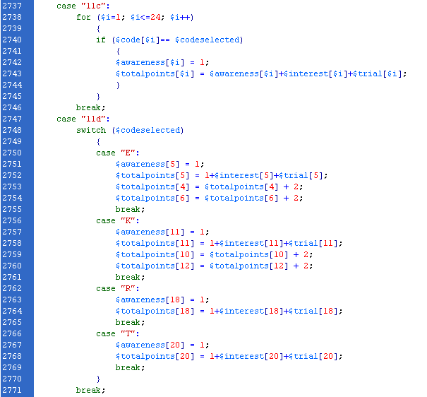
Case: The Diffusion Simulation Game (DSG)
Computational Model

Slide 30
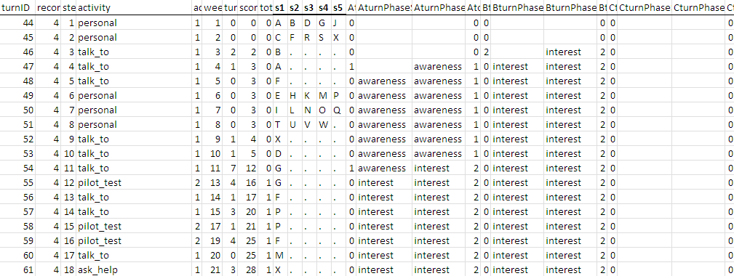
APT Classification and Categories
Variables
Activities
Cost (in weeks)
Staff members
Adopter type
Adoption phase
Game metrics
Adoption points
Number of adopters

Slide 31
Predicted Successful Strategies
Strategy 1: Target earlier adopters and opinion leaders early in the game to work toward critical mass
First 15 turns
Innovators, Early Adopters, Opinion Leaders F G H L M P X
Strategy 9: Use Training Workshop (Self) and Materials Workshop to gain points in Trial
How-to knowledge is essential when someone becomes willing to try an innovation
Help to reduce uncertainty and increase confidence

Slide 32
Predicted Successful Strategies
1: Target earlier adopters and opinion leaders early in the game to work toward critical mass
2: Use Personal Information and Talk To
3: Use Local Mass Media and Print to gain points in Awareness and Interest among earlier adopters
4: Use Presentation to gain points in Awareness and Interest
5: Use Demonstration, especially by an opinion leader, to gain points in Interest for other potential adopters
6: Use Site Visit to gain points in Interest and move into Trial
7: Use Pilot Test to gain additional points for those with some Interest or in Trial
8: Target highly connected individuals to gain points in Interest among later adopters in their social networks
9: Use Training Workshop (Self) and Materials Workshop to gain points in Trial

Slide 33
Calculating Strategy Scores
Strategy Scores
For every turn (n=107,294), calculate a score for each strategy; sum these for a Total Strategy score.
For every game (n=2,361), sum these scores.
Divide these sums by the number of turns taken in the game for a relative frequency score.

Slide 34
Preliminary Results
Correlations
 |  | Adoption Points | 1 Target early adopters | 2 Establish rapport | 3 Use mass media | 4 Use presentation | 5 Use demonstration by opinion leader | 6 Use site visit | 7 Use pilot test | 8 Target highly connected | 9 Use workshops
Adoption Points | Pearson Correlation | 1 | .288 | .020 | .433 | -.006 | .149 | .323 | -.441 | -.231 | .469
 | Sig. (2-tailed) |  | .000 | .335 | .000 | .776 | .000 | .000 | .000 | .000 | .000
1 Target early adopters | Pearson Correlation |  | 1 | -.026 | .116 | -.026 | .099 | .131 | -.067 | -.101 | .285
 | Sig. (2-tailed) |  |  | .206 | .000 | .206 | .000 | .000 | .001 | .000 | .000
2 Establish rapport | Pearson Correlation |  |  | 1 | -.471 | -.262 | .059 | -.314 | -.083 | .156 | -.220
 | Sig. (2-tailed) |  |  |  | .000 | .000 | .004 | .000 | .000 | .000 | .000
3 Use mass media | Pearson Correlation |  |  |  | 1 | .017 | -.142 | .383 | -.369 | -.295 | .276
 | Sig. (2-tailed) |  |  |  |  | .410 | .000 | .000 | .000 | .000 | .000
4 Use presentation | Pearson Correlation |  |  |  |  | 1 | -.052 | -.019 | -.007 | .036 | .085
 | Sig. (2-tailed) |  |  |  |  |  | .011 | .366 | .733 | .080 | .000
5 Use demonstration by opinion leader | Pearson Correlation |  |  |  |  |  | 1 | -.085 | .132 | .181 | -.025
 | Sig. (2-tailed) |  |  |  |  |  |  | .000 | .000 | .000 | .224
6 Use site visit | Pearson Correlation |  |  |  |  |  |  | 1 | -.215 | -.207 | .204
 | Sig. (2-tailed) |  |  |  |  |  |  |  | .000 | .000 | .000
7 Use pilot test | Pearson Correlation |  |  |  |  |  |  |  | 1 | .307 | -.261
 | Sig. (2-tailed) |  |  |  |  |  |  |  |  | .000 | .000
8 Target highly connected | Pearson Correlation |  |  |  |  |  |  |  |  | 1 | -.192
 | Sig. (2-tailed) |  |  |  |  |  |  |  |  |  | .000
9 Use workshops | Pearson Correlation |  |  |  |  |  |  |  |  |  | 1
 | Sig. (2-tailed)

Slide 35
Next Steps
Have strategies evaluated by experts
Run simulated games using these strategies
Finish MAPSAT APT software to query patterns

Slide 36
Analyzing Learner Discourse in New Media
Craig Howard

Slide 37
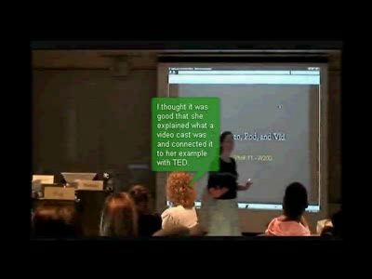
New Media: Collaborative Video Annotation (CVA)

Slide 38
The goals of discussion interventions in pre-service teacher education
Learners should problematize, “step away and discuss objectively, considering how multiple factors relate.” (Crotty 1998, Rosean et al., 2010)
Problematizing is most easily identified using Higher Order Thinking (HOT) ….

Slide 39
Target Performances of Higher Order Thinking (HOT)
Analysis (Booth & Hultén, 2003; Gunawardena et al., 1997; Hara et al., 2000; Henri, 1992; Marra, 2006; Marra et al., 2004; Newman et al., 1997; Pena-Shaff et al., 2004; Pena-Shaff & Nichols 2004).
Applications (Gunawardena et al., 1997; Hara et al., 2000; Henri, 1992; Marra, 2006; Marra et al., 2004; Newman et al., 1997; Pena-Shaff et al., 2004; Pena-Shaff & Nichols, 2004).
Modesty (Preston, 2010) is an aspect of higher order thinking unique to discussions among pre-service teachers.

Slide 40
The opportunities for scaffolds in the new media
Control (n=44): CVA over a 2 week period
Staggered participation (n=49): Learners were required to participate in two stages instead of one; a minimum of 3 annotations were required in each week instead of just 6 over the 2 week life of the task.
Planted modeled discourse (n=48): An expert session was held and the 4 interlocutors’ contributions were molded into a pair of “speakers” and planted into the space before learners entered.

Slide 41
Research Questions
How do 2 different scaffolds compare to an un-scaffolded version of a Collaborative Video Annotated (CVA) discussion in terms of the frequencies of Higher Order Thinking (HOT).
What discussion contributions precipitate HOT?

Slide 42
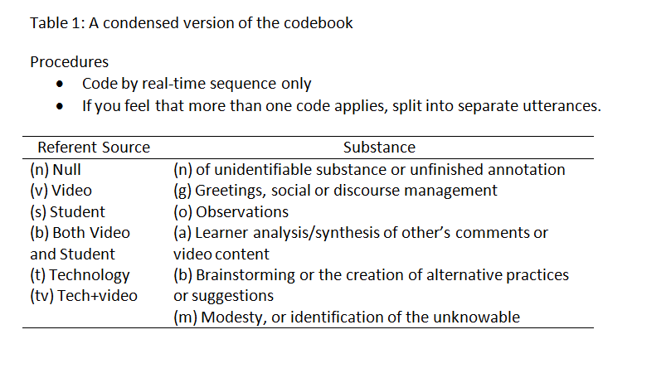
The codebook

Slide 43
Joint occurrences of Substance and Conditions
Cognitive contributions
Null / other
Greetings
Control
Staggered
Modeled Discourse
Observations
3 types of HOT
Applications
Modesty
Analysis

Slide 44
RQ1: All substance types across the 3 conditions

Slide 45
Results: RQ1-HOT across 3 conditions
 | Applications | Analysis | Modesty Statements | Total HOTS
Control (n=44) | 51 | 36 | 9 | 96
Staggered Participation (n=49) | 63 | 65 | 13 | 140
Modeled Discourse(n-48) | 60 | 79 | 26 | 165
Total | 174 | 180 | 48 | 402

Slide 46
Analyzing Patterns in Time (APT)
Data source: students’ CVA contributions (1274 annotation segments, 96% were whole annotations)
Looked at the patterns leading to sequences of Higher Order Thinking (HOT)

Slide 47
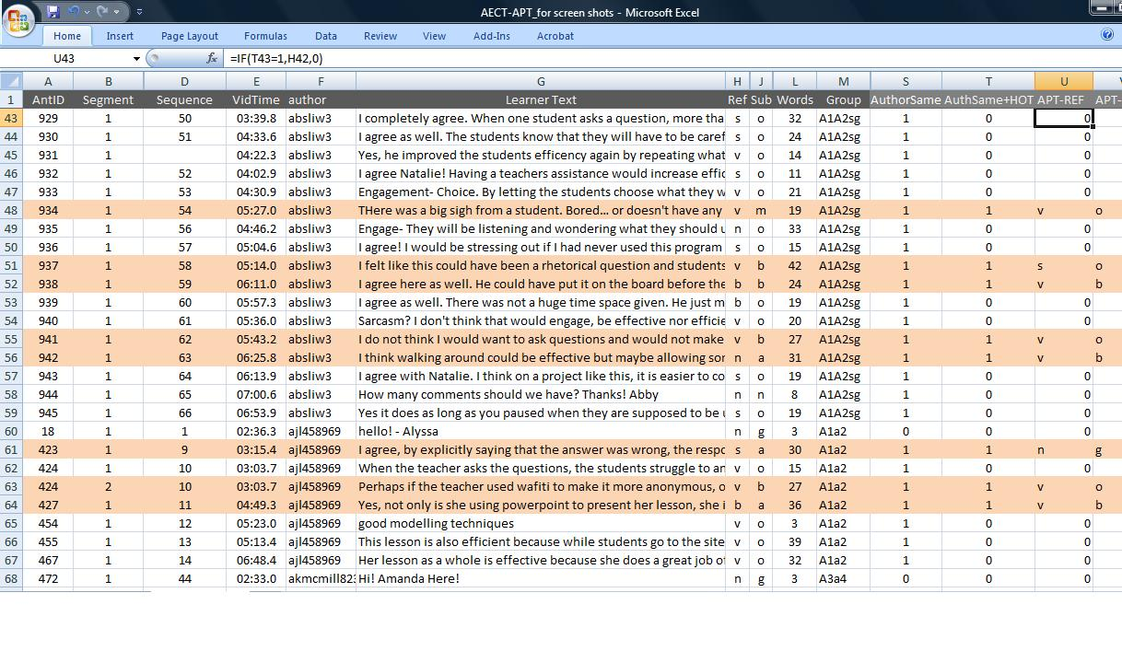
Coding: Operationalizing APT
Notes:
Talk about the codes:
Substance: reactionary, constructive, standard or null
Tenor: pos neg null
Word count
And patterns

Slide 48
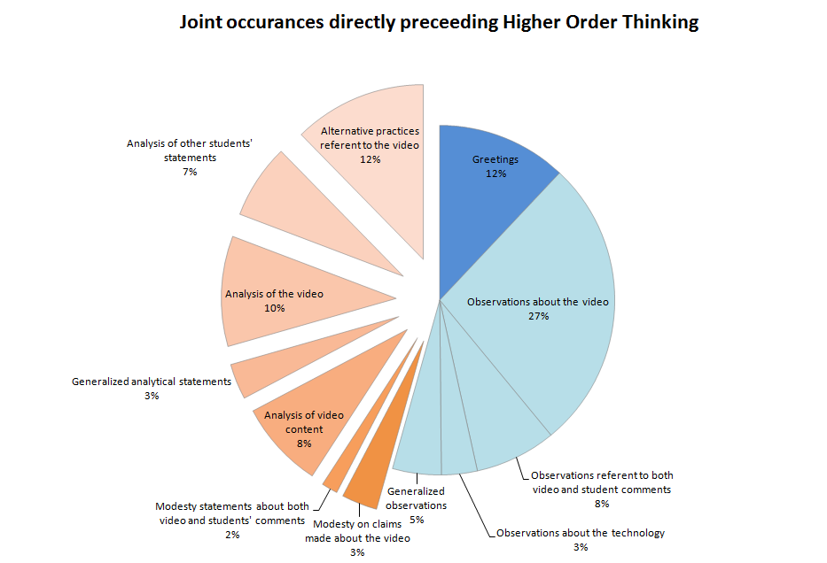
Results: APT
48

Slide 49
Percentages of substance types which are directly followed by HOT

Slide 50
Patterns of HOT HOT in 3 conditions
Application, analysis or modesty followed by application, analysis or modesty
Control | 25 cases
Staggered | 55 cases
Modeled | 73 cases
“Sustained academic discourse of 2 or more instances of higher order thinking is twice as likely in the staggered condition, and almost three times as likely in the modeled discourse condition, as in unscaffolded CVA.”

Slide 51
Discussion and Conclusions
Observations were the most common substance type, but were less likely to be directly followed by HOT. Analytical and modesty statements were the least frequent, but the most likely to be followed by HOT.
The modeled condition showed the smallest percentage of observations and the greatest percentage of higher order thinking, the staggered condition fell between the other 2 in terms of HOT.
APT can reveal probabilities of target discourses in in new media.

Slide 52
Applying APT in the Development of a New Item Calibration Approach for CAT
Andrew F. Barrett

Slide 53
Variable-Length Computer Classification Testing
Type of Computer Adaptive Testing focused on classification (e.g. master vs. nonmaster)
Classifies learner knowledge efficiently & accurately (Rudner, 2009; Thompson, 2007)
Often depends on item calibration involving thousands before testing can begin
Currently impractical in all but a few large-scale, high-stakes, and/or highly profitable contexts (Frick, 1992; Rudner, 2009; Welch & Frick, 1993)

Slide 54
Dissertation Study
Develop & test a new approach to item calibration, Automatic Racing Calibration Heuristics (ARCH), to bring advantages of VL-CCT to lower-stakes educational contexts
Analysis of Patterns in Time (APT) used to:
Make classification decisions based on examinee response patterns
Examine relationships between patterns of calibration heuristics, average test length, & frequency of classification decisions

Slide 55
An Example: Using Response Patterns to Make Classification Decisions
 | i | R | Probability of R To i From: |  | Probability Examinee Is A: |  | PR | Test Decision
 |  |  | Master | Nonmaster | Master | Nonmaster
Prior |  |  |  |  | .50 | .50 | 1.00 | Continue
1 | 63 | ✖ | .11 | .35 | .24 | .76 | 0.31 | Continue
2 | 23 | ✔ | .81 | .24 | .52 | .49 | 1.06 | Continue
3 | 1 | ✖ | .08 | .53 | .14 | .86 | 0.16 | Continue
4 | 38 | ✖ | .02 | .14 | .02 | .98 | 0.03 | Nonmaster
If an examinee answers item 63 incorrectly and item 23 correctly then testing should continue
If an examinee answers item 63 incorrectly, item 23 correctly, and items 1 and 38 incorrectly then testing should stop with a decision of nonmaster

Slide 56
Approaches to Item Calibration
Traditional Approach
Proposed ARCH Approach
Hundreds or thousands respond to items before testing begins
Large motivational differences exist between examinees who participate in item calibration, an often low or no stakes context, & actual test examinees (Wise & DeMars, 2006 in Makransky, 2010)
Tens of people respond to items before testing begins with item-pool level probabilities
Gather more data during online testing with real examinees
Use more precise item level probability once enough data has been collected

Slide 57
Item Calibration Heuristics: 3 Questions with 3 Possible Results
1. Has item i been given more than the maximum number of times? | Yes |  |  |  |  | A. Reject & stop calibrating item i
 | No | 2. Are nonmasters significantly more likely than masters to get item i correct? | Yes
 |  |  | No | 3. Are probability estimates sufficiently precise for item i? | Yes | B. Accept & stop calibrating item i
 |  |  |  |  | No | C. No decision, continue calibrating item i

Slide 58

Results Impacted by Adjusting Value of Maximum, Significance, & Precision
Image http://www.flickr.com/photos/jointhedots/4447606381/ via Creative Commons

Slide 59
Methods
Traditional Item Calibration
1. ARCH Calibration & Test Classifications
2. Traditional Test Classifications
Compare ARCH & Traditional Classifications to True Classifications

Slide 60
3 Types of Classification Decisions
True State | Classification Decision
 | Nonmaster | Master
Nonmaster | Correct | False Master
Master | False Nonmaster | Correct

Slide 61
Questions MAPSAT Can Help Answer
What is the relationship between ARCH settings & average test length?
What is the relationship between ARCH settings & classification accuracy?
How do ARCH based tests compare to traditionally calibrated tests in terms of average test length?
How do ARCH based tests compare to traditionally calibrated tests in terms of classification accuracy?

Slide 62
Learn More At Our Session Tomorrow
T103-R&T Reflection Paper: ARCH: Bridging the Divide Between Assessment Practice in Low and High-Stakes Contexts (Andrew F. Barrett, Theodore W. Frick)
Scheduled Time: Thu, Nov 10 - 10:30am - 11:30am
Building/Room: Hyatt Regency, Floor Level 3 - Conference Center A

Slide 63
Summary
Theodore W. Frick

Slide 64
Tradition vs. MAPSAT
Traditional approach: measure variables separately, then relate measures (e.g., correlational or regression analysis).
---------------------------------------------------------------------
MAPSAT approach: map relations by creating a
Temporal map, or
Structural map
Then analyze maps to generate values for
temporal properties (e.g., probabilities of event sequences) or
values of structural properties (e.g., strongness of the affect-relation configuration)

Slide 65
References
Alessi, S. & Trollip, S. (2000). Multimedia for learning: Methods and development (3rd ed.). Boston, MA: Allyn and Bacon.
Berliner, D. (1990). What's all the fuss about instructional time In M. Ben-Peretz & R. Bromme (Eds.), The nature of time in schools: Theoretical concepts, practitioner perceptions. New York: Teachers College Press.
Brandes, U. & Erlebach (Eds.) (2005). Network analysis: Methodological foundations. Berlin: Springer-Verlag.
Dreher, H., & Maurer, H. (2006, Jun 05, 2006). The worth of anonymous feedback. Paper presented at the 19th Bled Electronic Commerce Conference, Bled, Slovenia: European Commission.
Eckstein, J., Bergin, J., & Sharp, H. (2002). Feedback patterns. In A. O’Callaghan, J. Eckstein, and C. Schwanniger (Eds.), Proceedings of the Seventh European Conference on Pattern Languages of Programs (EuroPLoP’02) (343-373). Konstanz, Germany: UVK.
Enfield, J., Myers, R., & Lara, M. (2009). Assessing the fidelity of the Diffusion Simulation Game with the theory of diffusion of innovations. Manuscript in preparation.
Feinstein, A. H., & Cannon, H. M. (2002). Constructs of simulation evaluation. Simulation & Gaming, 33(4), 425-440.
Flinn, B., & Maurer, H. (1995). Levels of anonymity. Journal of Universal Computer Science, 1(1), 35-47.

Slide 66
References
Fraenkel, J. R., Wallen, N.E. (2006). How to design and evaluate research in education (6th ed.). New York: McGraw Hill Higher Education.
Frick, T.W. (1990). Analysis of patterns in time (APT): A method of recording and quantifying temporal relations in education. American Educational Research Journal, 27(1), 180-204.
Frick, T.W. Chadha, R., Watson, C., & Zlatkovska, E. (2008). Improving course evaluations to improve instruction and complex learning in higher education. Featured research paper presented at the annual conference of the Association for Educational Communications & Technology, Orlando, FL.
Frick, T., Myers, R., Thompson, K. & York, S. (2008). New ways to measure systemic change: Map & Analyze Patterns & Structures Across Time (MAPSAT). Featured research paper presented at the annual conference of the Association for Educational Communications & Technology, Orlando, FL.
Herring, S. C. (2001). Computer-mediated discourse. Handbook of discourse analysis, 612-634.
Herring, S. C. (2004). Computer-mediated discourse analysis: An approach to researching online behavior. In S. A. Barab, R. Kling & J. H. Gray (Eds.), Designing for virtual communities (338-376). New York: Cambridge University Press.

Slide 67
References
Howard, C. D. & Barrett, A. F. (2009, April). Anonymity in online peer reviews: Preservice teachers’ online comments in two critique designs. Paper presented at the American Educational Research Association Annual Meeting, San Diego, CA.
Jensen, F. & Nielsen, T. (2007). Bayesian networks and decision graphs (2nd ed.). NY: Springer.
Koh, J. & Frick, T. (2007). Measuring system structural properties of autonomy-support in a Montessori classroom. Proceedings of the Association for Educational Communication and Technology, Anaheim, CA. Available online at: http://www.indiana.edu/~tedfrick/montessori_AECT2007_proceedings_koh_frick.pdf.
Lin, S. S. J., Liu, E. Z. F., & Yuan, S. M. (2001). Web-based peer assessment: feedback for students with various thinking-styles. Journal of Computer Assisted Learning, 17(4), 420-432.
Merrill, M. D. (2002). First principles of instruction. Educational Technology Research & Development, 50(3), 43-59.
Mishra, P., & Koehler, M. (2006). Technological pedagogical content knowledge: A framework for teacher knowledge. The Teachers College Record, 108(6), 1017-1054.
Moursund, D., & Bielefeldt, T. (1999). Will new teachers be prepared to teach in a digital age? A national survey on information technology in teacher education (Research Study). Santa Monica, CA: Milken Family Foundation.

Slide 68
References
Pfitzmann, A., & Köhntopp, M. (2001). Anonymity, unobservability, and pseudonymity — A Proposal for terminology. In Designing privacy enhancing technologies (pp. 1-9). Berlin: Springer Verlag.
Picard, R. W., Papert, S., Bender, W., Blumberg, B., Breazeal, C., Cavallo, D., et al. (2004). Affective learning—a manifesto. BT Technology Journal, 22(4), 253-269.
Postmes, T., Spears, R., & Lea, M. (1998). Breaching or building social boundaries: SIDE-effects of computer-mediated communication. Communication Research, 25(6), 689-715.
Postmes, T., Spears, R., Sakhel, K., & de Groot, D. (2001). Social influence in computer-mediated communication: The effects of anonymity on group behavior. Personality and Social Psychology Bulletin, 27(10), 1243-1254.
Rangel, E. & Berliner, D. (2007). Essential information for education policy: Time to learn. Research Points: American Educational Research Association, 5(2), 1-4.
Reigeluth, C. (2009). Instructional-design theories and models, Volume III (1st ed.). New York: Routledge.
Reigeluth, C. M., & Schwartz, E. (1989). An instructional theory for the design of computer-based simulations. Journal of Computer-Based Instruction, 16(1), 1-10.
Rheingold, H. (2000). The virtual community: Homesteading on the electronic frontier. Reading, MA: Addison-Wesley.

Slide 69
References
Rogers, E. M. (2003). Diffusion of innovations (5th ed.). New York: The Free Press.
Schwier, R. A., Campbell, K., & Kenny, R. (2004). Instructional designers' observations about identity communities of practice, and change agency. Australian Journal of Educational Technology, 20(1), 69-100.
Shute, V. J. (2008). Focus on formative feedback. Review of Educational Research, 78(1), 153-189.
Thompson, K. R. (2006a). General system defined for A-GSBT. Scientific Inquiry Journal, 7(1), 1-12. Retrieved July 4, 2007: http://www.iigss.net/Scientific-Inquiry/THOMPSON-1.pdf.
Thompson, K. R. (2006b). Axiomatic theories of intentional systems: Methodology of theory construction. Scientific Inquiry Journal, 7(1), 13-24. Retrieved July 4, 2007: http://www.iigss.net/Scientific-Inquiry/THOMPSON-2.pdf.
Thompson, K. R. (2008). ATIS graph theory. Columbus, OH: System-Predictive Technologies. Retrieved July 4, 2007: http://www.indiana.edu/~aptfrick/reports/11ATISgraphtheory.pdf .
Topping, K. (1998). Peer assessment between students in colleges and universities. Review of Educational Research, 68(3), 249.
Walther, J. (1996). Computer-mediated communication: Impersonal, interpersonal and hyperpersonal interaction. Communication Research, 23(1), 3-34.

Slide 70
References
Warschauer, M. (2004). Technology and social inclusion: Rethinking the digital divide. Cambridge, MA: MIT Press.
Winn, W. (2002). Current trends in educational technology research: The study of learning environments. Educational Psychology Review, 14(3), 331-352.
Zhang, G., & Zhao, Y. (2008). The effects of anonymity on critical feedback in a teacher preparation program. Paper presented at the Society for Information Technology and Teacher Education International Conference 2008, Chesapeake, VA.
Zhao, Y. (1998). The effects of anonymity on computer-mediated peer review. International Journal of Educational Telecommunications, 4(4), 311-345.

Slide 71
Websites for more information
http://www.indiana.edu/~aptfrick
http://www.indiana.edu/~simed
http://www.indiana.edu/~tedfrick
http://www.indiana.edu/~istdemo

